Slide 1

M.S. Ramaiah Institute of Technology (Autonomous Institute, Affiliated to VTU)
Department of Computer Science and Engineering
Course Name: Cryptography and Network Security Course Code – CSE555
Credits - 3:0:0
UNIT -1
Term: October 2024 – January 2025

Slide 2
OUTLINE
Introduction: (TextBook1 - Chapter 1)
oSecurity Goals
oAttacks
oServices and Mechanism
oTechniques
Mathematics of Cryptography: (TextBook1 - Chapter 2)
oInteger Arithmetic oModular Arithmetic oMatrices
oLinear Congruence

Slide 3
Security Goals
Security refers to the methods and tools to defend an organization's digital assets.
The goal of IT security is to protect these assets, devices and services from being disrupted, stolen or exploited by unauthorized users, otherwise known as Threats.
These threats can be external or internal and malicious in both origin and nature.

Slide 4
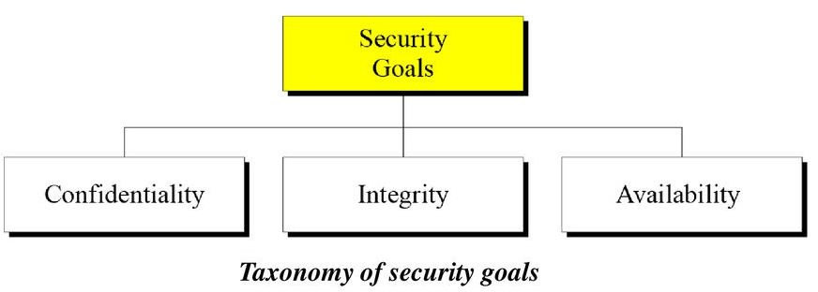
Security Goals
All information security measures try to address at least one of three goals as
shown in Figure:
oProtect the Confidentiality of data
oPreserve the Integrity of data
oPromote the Availability of data for authorized use

Slide 5
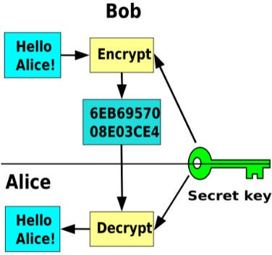
Security Goals
Confidentiality is probably the information security. We need information.
most common aspect of to protect confidential
An organization needs to guard against those malicious actions that endanger the confidentiality of its information.
Confidentiality is the protection of data, providing access for those who are allowed to see it while disallowing others from learning anything about its content.
Example : Banking, Military, Industry

Slide 6
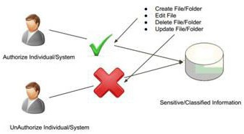
Security Goals
Information needs to be changed constantly.
Integrity means changes need to be done only by authorized entities and through authorized mechanisms.
Example deposit
: In Bank, when customer or withdraw, balance of
account need to be changed

Slide 7
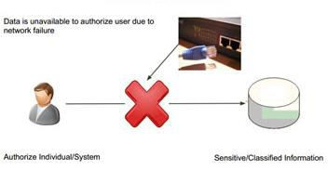
Security Goals
The information created and stored by an organization needs to be available to authorized entities.
Information needs to be constantly changed, which means it must be accessible to authorized entities.
Availability is the property in which information is
accessible and modifiable by authorized entities.
Example : Imagine what would happen to a bank if the customers could not access their accounts for transactions.

Slide 8
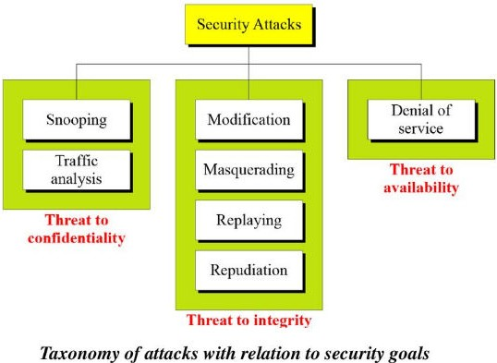
Attacks
The three goals of security - confidentiality, integrity, and availability can be threatened by security attacks.
We can divide them into 3 groups related to security goals

Slide 9
Attacks
An attack is a threat that involves an attempt to obtain,
alter, destroy, remove, implant or reveal information
without authorized access or permission.
It happens to both individuals and organizations.

Slide 10
Attacks
Attacks Threatening Confidentiality
1. Snooping refers to unauthorized access to or interception of data.
Example : File transferred through internet may contain confidential information.

Slide 11
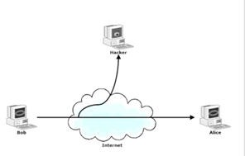
Attacks
Attacks Threatening Confidentiality
2. Traffic analysis refers to obtaining some other type of information by monitoring online traffic.
Example : File transferred through internet

Slide 12
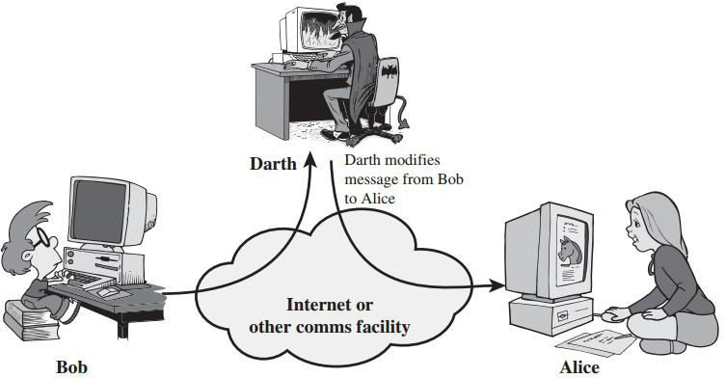
Attacks
Attacks Threatening Integrity
1. Modification means that the attacker intercepts the message and changes it.
Example: Customer send a message to bank to do some transaction.

Slide 13
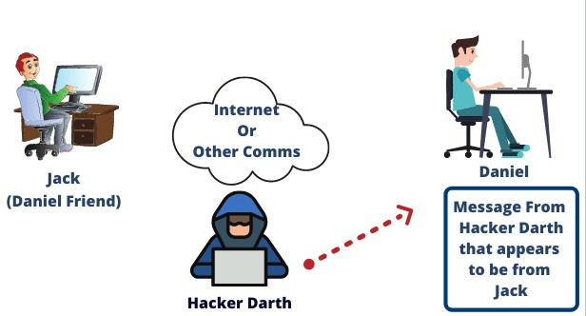
Attacks
Attacks Threatening Integrity
2. Masquerading or spoofing happens when the attacker impersonates somebody else.
Example: Attacker can steal the pin of a bank customer and pretend that he/she is customer

Slide 14
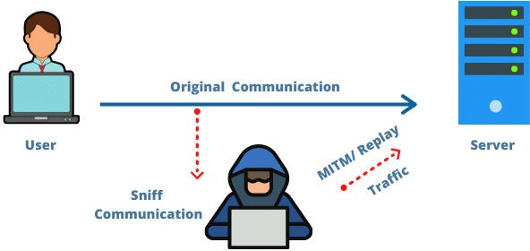
Attacks
Attacks Threatening Integrity
3. Replaying means the attacker obtains a copy of a message sent by a user and later tries to replay it.
Example: Customer sends a request to her bank to ask for payment.

Slide 15
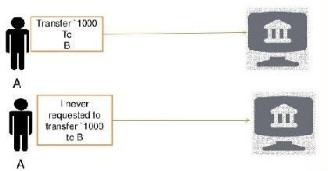
Attacks
Attacks Threatening Integrity
4. Repudiation means that sender of the message might later deny that she has sent the message; the receiver of the message might later deny that he has received the message.
Example: Denial by the sender would be a bank customer asking her bank to send money to third party

Slide 16
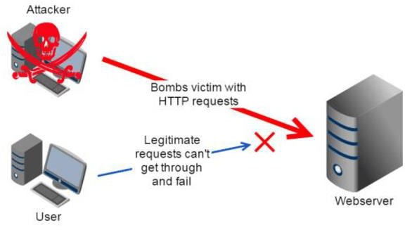
Attacks
Attacks Threatening Availability
1. Denial of service (DoS) attacks may slow down or totally interrupt the service of a system.
The attacker can use several strategies to achieve this.
o Send bogus request to a server, so that the server crashes because of heavy load.
Attacker intercept request from client, causing client to
resend many times and overload the server.
Attacker intercept server response and delete, so that client believe server is not responding
o
o

Slide 17
Attacks
Passive Attacks
Attackers goal is just to obtain information.
Attack does not modify data or harm the system. The system continues with normal operation.
However, attack may harm the sender or receiver of the message
Attacks Threatening Confidentiality – Snooping and Traffic analysis are passive attacks

Slide 18
Attacks
Active Attacks
Active attack may change the data or harm the system.
Attacks Threatening Integrity and Availability are active attacks
These type of attacks are easy to detect, than to prevent

Slide 19
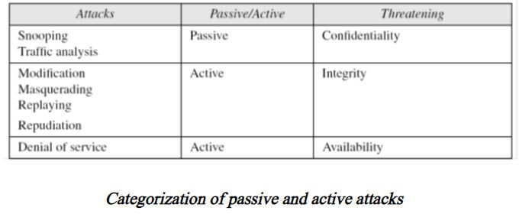
Attacks
Passive versus Active Attacks

Slide 20
OSI Security Architecture
Security Attacks
Security Services
Security Mechanisms

Slide 21
Services and Mechanisms
ITU-T (International Telecommunication
Union- Telecommunication Standardization Sector) provides
security services and security mechanisms.
Security services are the communication service that is provided by a system to give a specific kind of protection to system resources.
Security service implement security policies and are implemented by security mechanisms

Slide 22
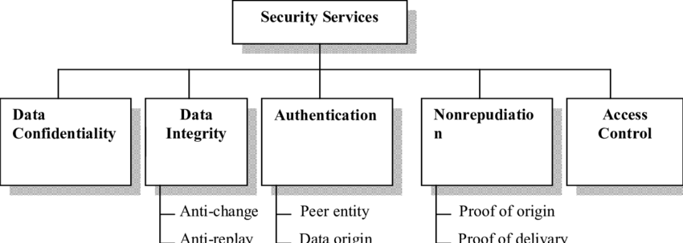
Services and Mechanisms
Security Services
Figure shows the taxonomy of the five common services.

Slide 23
Services and Mechanisms
Security Services 1.Data Confidentiality
Data Confidentiality deals with protecting against the disclosure of information by ensuring that the data is limited to those authorized user.
Represent the data in such a way that its semantics remain accessible only to those who possess some critical information.

Slide 24
Services and Mechanisms
Security Services
2.Data Integrity
Data integrity is a technique when sent message is delivered to receiver as the same.

Slide 25
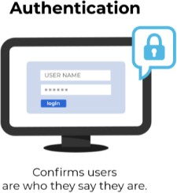
Services and Mechanisms
Security Services
3.Authentication
Authentication is the act of validating that users are whom they claim to be.
Verifying the identity of a user, process or device, often as a prerequisite to allowing access to resources in an information system.
Passwords, One-time pins, Biometrics
Example :
Logging into your computer system at the office
Checking your account balance on your bank website

Slide 26

Services and Mechanisms
Security Services
4. Nonrepudiation
Non-repudiation is the assurance that someone cannot deny the validity of something.

Slide 27
Services and Mechanisms
Security Services
5. Access control
Access control is a security technique that regulates who or what can view or use resources in a computing environment.
Example:
Banking Manager will have more privilege to access resource than others

Slide 28
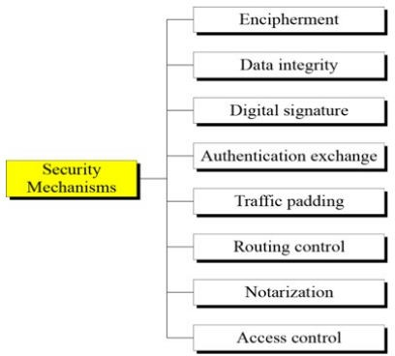
Services and Mechanisms
Security Mechanisms
ITU-T(X.800) Standard recommends security mechanisms to provide security services.
Figure shows the taxonomy of these mechanisms.

Slide 29
Services and Mechanisms
Security Mechanisms
Encipherment – Hiding or covering data can provide confidentiality. 2 techniques are Cryptography and Steganography
Data Integrity – Data integrity mechanism appends to the data a short check value that has been created by a specific process from the data itself.
Digital Signature – The Sender can electronically sign the data and the receiver can electronically verify the signature.
Authentication exchange – Two entities exchange some message to prove their identity to each other.

Slide 30
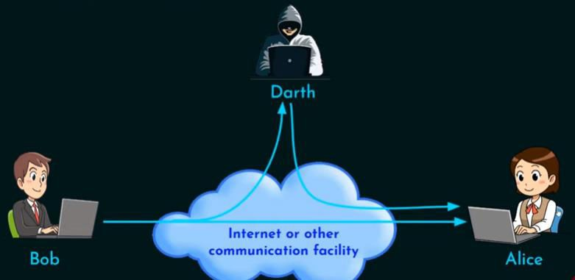
Services and Mechanisms
Security Mechanisms
5.Traffic Padding – Inserting some bogus data into the traffic to thwart the
adversary’s attempt to use the traffic analysis.

Slide 31
Services and Mechanisms
Security Mechanisms
Routing control – Selecting and continuously changing different available routes between the sender and receiver to prevent the opponent from evaesdropping on a particular route.
Notarization – Selecting a third party to control the communication between two entities.
Access control – Uses method to prove that a user has access right to the data or resources owned by a system.

Slide 32
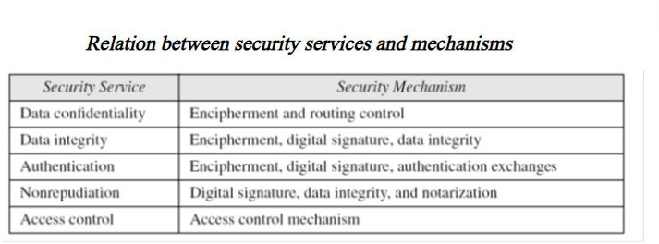
Services and Mechanisms
Relation between Services and Mechanisms

Slide 33
Techniques
The actual implementation of security goals needs some help from mathematics.
Two techniques are prevalent today:
Cryptography
Steganography

Slide 34
Techniques
Cryptography
Cryptography is a word with Greek origins, means
“secret writing”
Symmetric key Encipherment
Asymmetric key Encipherment
Hashing

Slide 35
Techniques
Plaint text - original message
Cipher text - encrypted or coded message
Cryptographic algorithm(cipher) is a mathematical function which uses plaintext as the input and produces ciphertext as the output and vice versa.
Encryption - convert from plaintext to ciphertext (enciphering)
Decryption - restore the plaintext from ciphertext (deciphering)

Slide 36
Techniques
Key - is a string of characters used within an encryption algorithm for altering data so that it appears random.
The length of a key is normally expressed in bits.
A longer key makes it more difficult to crack the encrypted data; however, a longer key results in longer time periods to perform encryption and decryption processes.

Slide 37
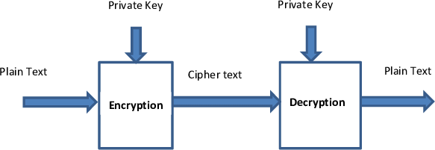
Techniques
Secret key : is a piece of information that is used to decrypt and encrypt messages.
Private key : (secret key) is used for encryption and decryption.
This key is symmetric because the only key is copied or shared by another party to decrypt the cipher text.

Slide 38
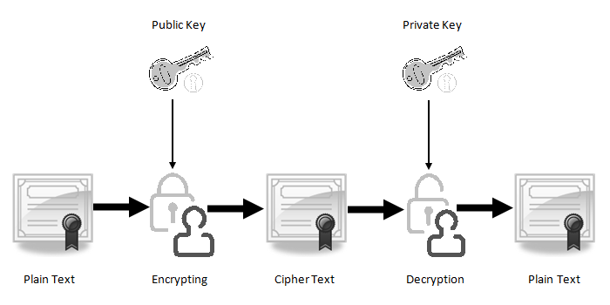
Techniques
Public key :
Two keys are used
One key is used for encryption
And another key is used for decryption.
One key (public key) is used for encrypt the plain text to convert it into cipher text and another key (private key) is used by receiver to decrypt the cipher text to read the message.

Slide 39
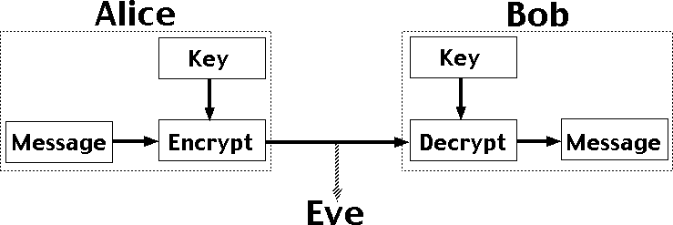
Techniques
Symmetric key Encipherment
Alice send a message to Bob ,over an insecure channel with the assumption that an adversary, say Eve, cannot understand the contents of the message by simply eavesdropping over the channel.
Alice encrypts the message using an encryption algorithm.
Bob decrypts the message using a decryption
algorithm.

Slide 40
Techniques
Symmetric key Encipherment
Symmetric-key encipherment uses a single secret key for both encryption and decryption.
In symmetric-key enciphering, Alice puts the message in a box and locks the box using the shared secret key.
Bob unlocks the box with the same key and takes out the messages.

Slide 41
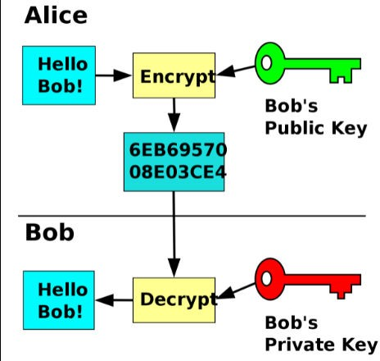
Techniques
Asymmetric key Encipherment
Two keys are used public key and private key.
To send a secure message to Bob, Alice firsts encrypts the message using Bob’s public key.
To decrypts the message, Bob uses his own private key

Slide 42
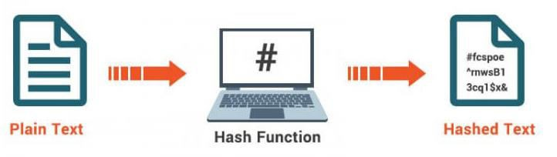
Techniques
Hashing
A fixed-length message digest is created out of a variable- length message.
The digest is normally much smaller than the message.
Hashing is used to provide check values, provides data integrity.

Slide 43
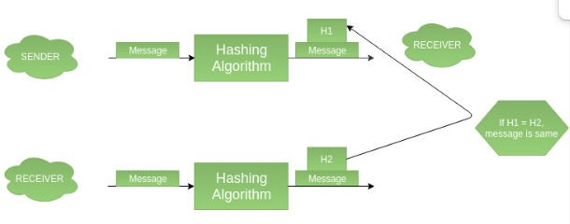
Techniques
Hashing

Slide 44
Techniques
Steganography
The main idea behind steganography is to hide the existence of data in any medium like audio, video, image, etc.
Steganography in Greek means “covered writing”
Historical use
Modern use
Text cover
Image cover

Slide 45
Techniques
Steganography - Historical use
China war – Messages were written on thin pieces of silk and rolled into a small ball and swallowed by the messenger.
Rome and Greece – Messages were carved on pieces of wood, that were dipped into wax to cover the writing.

Slide 46
Techniques
Steganography - Historical use
Invisible inks(Onion juice/Ammonia salts) used to write secret messages, when heated with another substance, secret message are exposed.
Some letters in an innocuous message might be overwritten in a pencil lead that is visible when exposed to light at an angle.

Slide 47
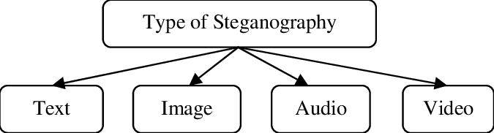
Techniques
Steganography – Modern use Different forms of data can be digitized

Slide 48
Techniques
Steganography – Modern use – Text cover
The cover of secret data can be text.
Several ways to insert binary data into an text
Example : single space – 0
double space - 1

Slide 49
Techniques
Steganography – Modern use – Text cover
The cover of secret data can be text.
Several ways to insert binary data into an text
Example : single space – 0
double space - 1

Slide 50
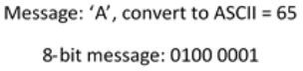
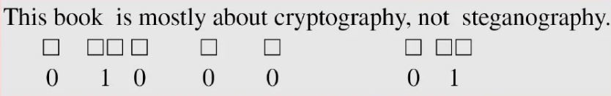
Techniques
Steganography – Modern use – Text cover
The cover of secret data can be text.
Several ways to insert binary data into an text
Example 1: single space – 0
double space – 1

Slide 51
Techniques
Steganography – Modern use – Text cover
Example 2:
Use dictionary of words organized according to their grammatical usages.
Consider a Dictionary contains 2 articles ,8 verbs , 32 nouns, 4 prepositions
Use sentences with pattern article-noun-verb-article-noun

Slide 52
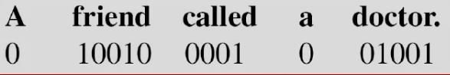
Techniques
Steganography – Modern use – Text cover
Example 2:
Secret binary data is divided into 16-bit chunks.
First bit of binary data can be represented for an article 0 – a
Secret data = HI ➔ 01001000
01001001
1 – the
Next 5 bits can be represented by a noun
Next 4 bits can be represented by a verb
next bit by the second article
last 5 bits by another noun
article
noun
verb
article
noun

Slide 53
Techniques
Steganography – Modern use – Image cover
Secret data can also be covered under a color image.
Image made of pixels(24 bits – 3 bytes) (red,green,blue)

Slide 54
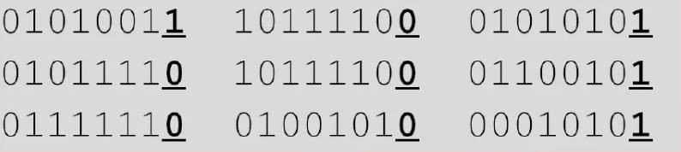
Techniques
Steganography – Modern use – Image cover
LSB(least significant bit)
To hide binary data in image, keep or change least significant bit
If binary data is 0 , keep the bit
If binary data is 1, change the bit to 1
Secret data = M

Slide 55
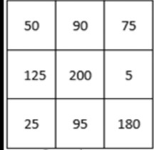
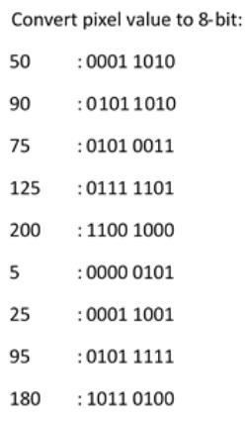
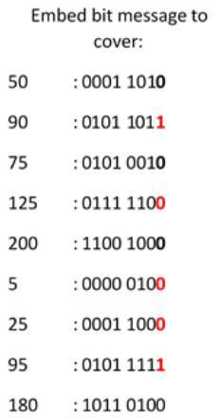
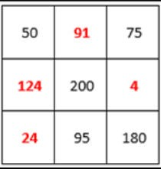
Techniques
Steganography – Modern use – Image cover
LSB(least significant bit)

Slide 56
Techniques
Steganography – Modern use – Other cover
Secret data can also be covered using audio and video

Slide 57
Integer Arithmetic
In integer arithmetic, we use a set and a few operations.
Are used to create a background for modular arithmetic.
Set of Integers
Binary Operations
Integer Division
Divisibility

Slide 58
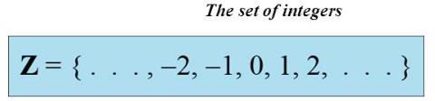
Integer Arithmetic
Set of Integers
The set of integers, denoted by Z, contains all integral numbers (with no fraction) from negative infinity to positive infinity as shown in Figure.

Slide 59
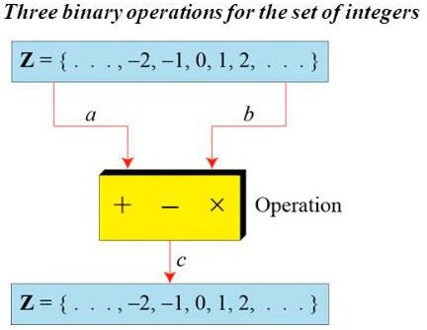
Integer Arithmetic
Binary Operations
In cryptography, three binary operations applied to the set of integers.
A binary operation takes two inputs and creates one output.
Figure shows three binary operations for the set of integers

Slide 60
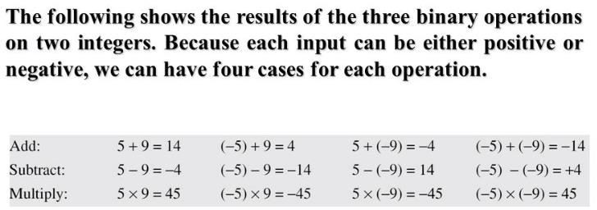
Integer Arithmetic
Binary Operations

Slide 61
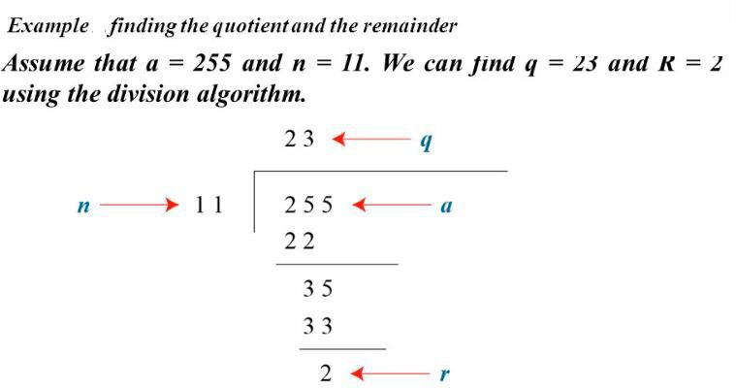
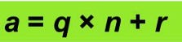
Integer Arithmetic
Integer Division
In integer arithmetic, if we divide a by n, we can get q and r . The relationship between these four integers can be shown
a is dividend q is quotient n is divisor
r is remainder
Operator / for quotient and % for Remainder

Slide 62
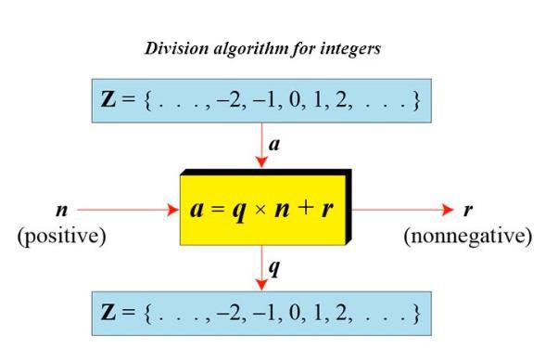
Integer Arithmetic
Integer Division
To perform division in cryptography, we impose 2 restrictions
Require n should be a positive integer (n>0)
Require r remainder should be a nonnegative integer(r≥ 0)
DEPARTMENT OF COMPUTER SCIENCE AND ENGINEERING
62

Slide 63
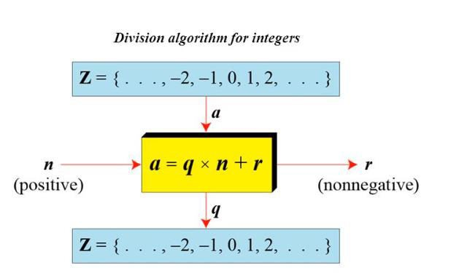
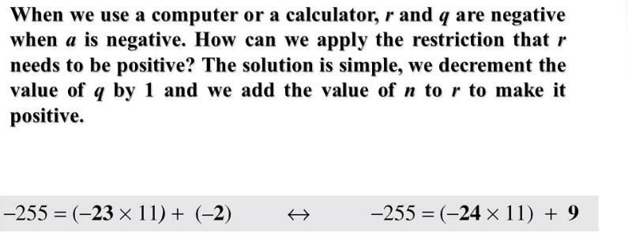
Integer Arithmetic
Integer Division
DEPARTMENT OF COMPUTER SCIENCE AND ENGINEERING
63

Slide 64
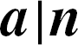
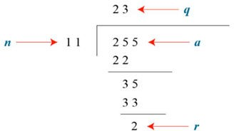

Divisbility
If a is not zero and we let r = 0 in the division relation, we get
a = q × n
If the remainder is zero,
If the remainder is not zero,

Slide 65
Property 1: if a|1, then a = ±1.
Property 2: if a|b and b|a, then a = ±b. Property 3: if a|b and b|c, then a|c.
Property 4: if a|b and a|c, then
a|(m × b + n × c),
where m and n are arbitrary integers

Slide 66

Note
Fact 1: The integer 1 has only one divisor, itself.
Fact 2: Any positive integer has at least two divisors, 1 and itself (but it can have more).

Slide 67
Greatest Common Divisor
The greatest common divisor of two positive integers is the largest integer that can divide both integers.

Slide 68
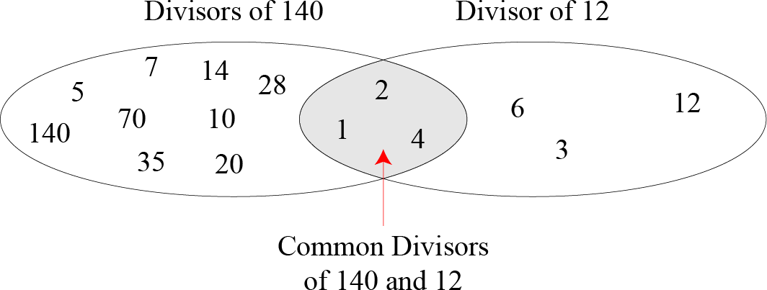
Common divisors of two integers

Slide 69
Euclidean Algorithm
Finding GCD of two positive integer by listing all common divisor is not easy when two integer are large.
Mathematician Euclid developed algorithm to find gcd of 2 positive integer
It is based on two facts
Fact 1: gcd (a, 0) = a
Fact 2: gcd (a, b) = gcd (b, r)
where r is the remainder of dividing a by b

Slide 70
GCD( 36,10)
10)36(3
30
GCD(10,6) |  | 6 ) 10 (1
 |  | 6
GCD(6,4) |  | 4) 6 ( 1
 |  | 4
GCD(4,2) |  | 2 ) 4 (2
 |  | 4
GCD(2,0) | = 2 | 0
The second fact allow to change value of a and b , until b becomes 0, GCD(36,10) = 2
DEPARTMENT OF COMPUTER SCIENCE AND ENGINEERING
70

Slide 71
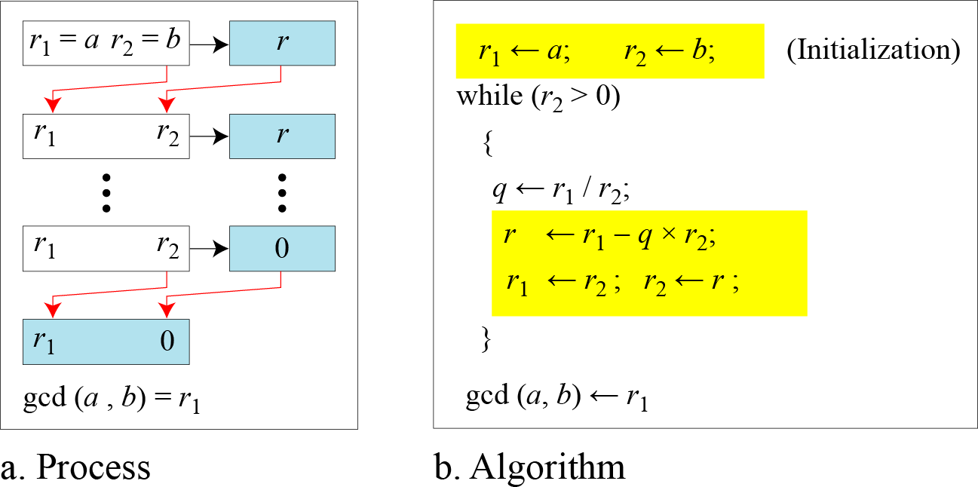
Euclidean Algorithm
When gcd (a, b) = 1, we say that a and b are relatively prime.

Slide 72
Note
When gcd (a, b) = 1, we say that a and b are relatively prime.

Slide 73
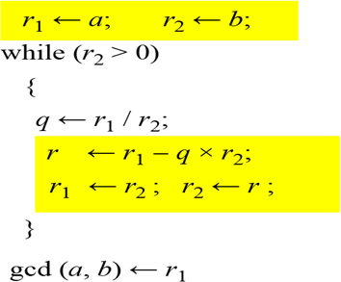






















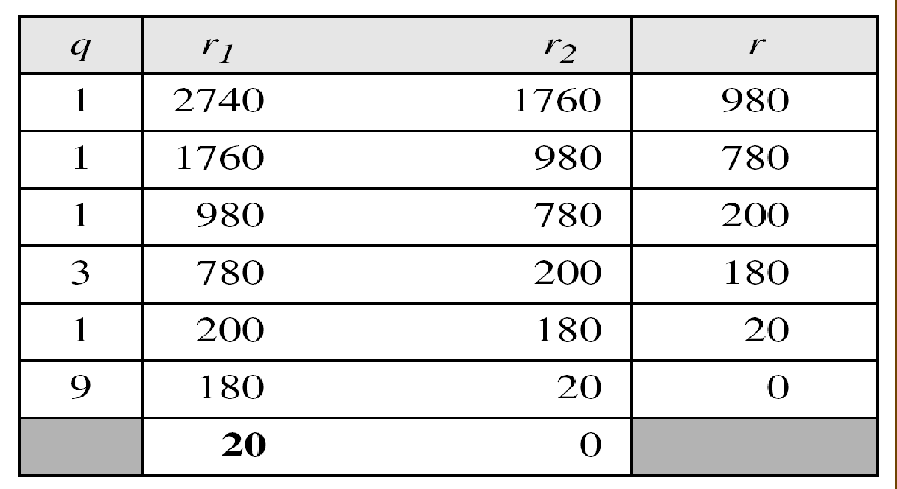
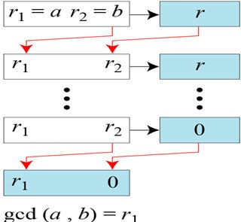
Find the greatest common divisor of 2740 and 1760. Solution
We have gcd (2740, 1760) = 20.

Slide 74
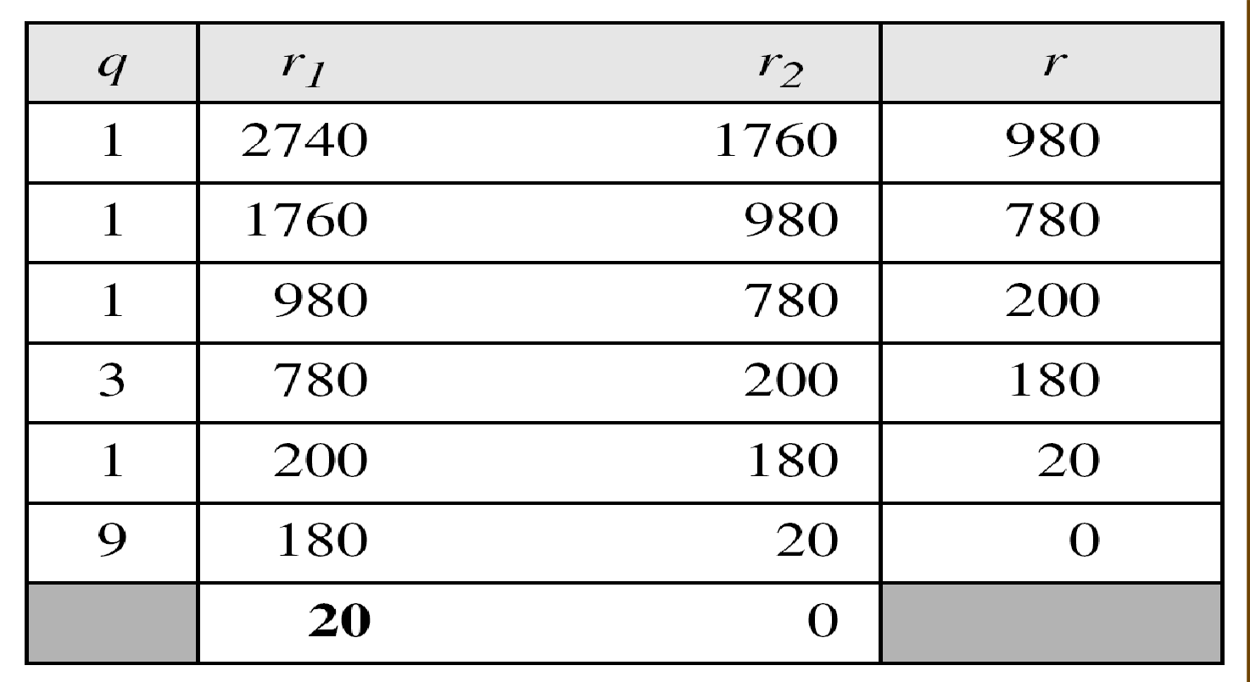
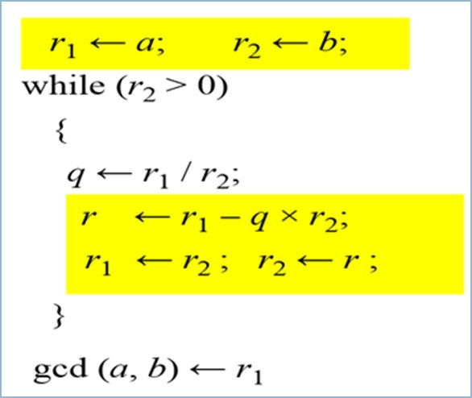
1760)2740( 1
1760
980 ) 1760 (1
980
780) 980 ( 1
780
200 ) 780 (3
600
180 )200 (1
180
20)180(9
180
0

Slide 75










Find the greatest common divisor of 25 and 60.

Slide 76





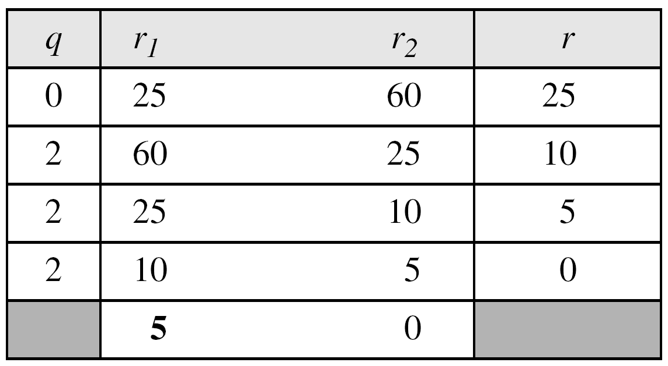
Find the greatest common divisor of 25 and 60.
Solution
We have gcd (25, 60) = 5.

Slide 77






































Extended Euclidean Algorithm
Given two integers a and b, we often need to find other two integers, s and t,
such that
The extended Euclidean algorithm can calculate the gcd (a, b) and at the same time calculate the value of s and t.

Slide 78

Extended Euclidean algorithm, part a

Slide 79




Extended Euclidean algorithm

Slide 80






































Given a = 161 and b = 28, find gcd (a, b) and the values of s and t.
Solution
We get gcd (161, 28) = 7, s = −1 and t = 6.
-1 X 161 + 6 X 28 = 7
2.80

Slide 81
































(a, b) and the values of s
Given a = 17 and b = 0, find gcd and t.
Solution
We get gcd (17, 0) = 17, s = 1, and t = 0.

Slide 82

































a = 0 and b = 45, find gcd (a, b) and the values of s
Given and t.
Solution
We get gcd (0, 45) = 45, s = 0, and t = 1.

Slide 83





































MODULAR ARITHMETIC
The division relationship (a = q × n + r) discussed in the previous section has two inputs (a and n) and two outputs (q and r).
In modular arithmetic, we are interested in only one of the outputs, the remainder r.

Slide 84

Modulo Operator
The modulo operator is shown as mod. The second input (n) is called the modulus. The output r is called the residue.
Division algorithm
modulo operator

Slide 85

Congruence
In cryptography, we often use the concept of congruence instead of equality.
To show that two integers are congruent, we use the congruence operator ( ≡ ).
We add the phrase (mod n) to the right side of the congruence to define the value of modulus that makes the relationship valid.
For example

Slide 86


Set of Residues
The result of the modulo operation with modulus n is always an integer between 0 and n-1.
The modulo operation creates a set, which in modular arithmetic is referred to as the set of least residues modulo n, or Z_{n}.
Some Z_{n} sets

Slide 87

Concept of congruence

Slide 88

Operation in Z_{n}
The three binary operations that we discussed for the set Z can also be defined for the set Zn.
The result may need to be mapped to Zn using the mod operator.
Binary operations in Z_{n}

Slide 89





























Perform the following operations (the inputs come from Z_{n}):
Add 7 to 14 in Z₁₅.
Subtract 11 from 7 in Z₁₃.
Multiply 11 by 7 in Z₂₀.
Solution

Slide 90



































Perform the following operations (the inputs come from either Z or Z_{n}):
Add 17 to 27 in Z14.
Subtract 43 from 12 in Z13.
Multiply 123 by −10 in Z₁₉.
Solution

Slide 91


Slide 92


Properties of mode operator

Slide 93

































Inverses
When we are working in modular arithmetic, we often need to find the inverse of
a number relative to an operation.
We are normally looking for an
additive inverse (relative to an addition operation) or
multiplicative inverse (relative to a multiplication operation).

Slide 94






















Additive Inverse
In Z_{n}, two numbers a and b are additive inverses of each other if
Note
In Z_{n} , additive inverse a can be calculated as b=n-a

Slide 95



























Find the additive inverse of 4 in Z₁₀.
Solution
The additive inverse of 4 in Z₁₀
is 10 - 4 = 6
In Z_{n} , additive inverse a can be calculated as b= n - a

Slide 96






















Multiplicative Inverse
In Z_{n}, two numbers a and b are the multiplicative inverse of each other if
Note
The integer a in Z_{n} has a multiplicative inverse if and only if
gcd(a , b) ≡ 1 (mod n)

Slide 97



Using extended Euclidean algorithm to find multiplicative inverse of b in Z_{n}

Slide 98



























Find the multiplicative inverse of 11 in Z₂₆. Solution
The gcd (26, 11) is 1; the inverse of 11 is −7 or -7mod 26 =19.

Slide 99








Find the multiplicative inverse of 23 in Z₁₀₀. Solution
The gcd (100, 23) is 1; the inverse of 23 is −13 or 87.

Slide 100







Find the inverse of 12 in Z₂₆. Solution
The gcd (26, 12) is 2; the inverse does not exist.

Slide 101
THANK YOU
101

